Slide 1


Inflation Investing in 2022
Adwoa Mante & Jacqueline Raynolds
1/18/2024

Slide 2
Project Overview
The aim of this project was two-fold. First, we aimed analyze the scope and significance of inflation in 2022. Second, we aimed to analyze inflation impacted securities - specifically I bonds and S&P 500 stocks - and made investing recommendations, based on that analysis.

Slide 3
Approach
Divided task:
Data analysis of inflation indicators
Analysis of stock data
Github:
Organization (required for “Project”)
Project: PM tool ☹
Repository
2 branches
Pull requests with
Communication:
Slack
SMS
In-class progress checkups & to-do lists
Challenges:
Maintaining Focus and Scope
Skill and knowledge → more collaborators would have been helpful

Slide 4
Research Questions
How much did inflation increase across the world in 2022?
Where did inflation increase significantly?
How significant was inflation in the United States?
How did inflation impact the I bond market, a risk-free investment for retail investors?
Which stocks in the S&P 500 performed the best?
How did the S&P 500 perform?
How risky was the equity market?
Compare the index, top performers, and I bonds as options for investments for retail investors.

Slide 5
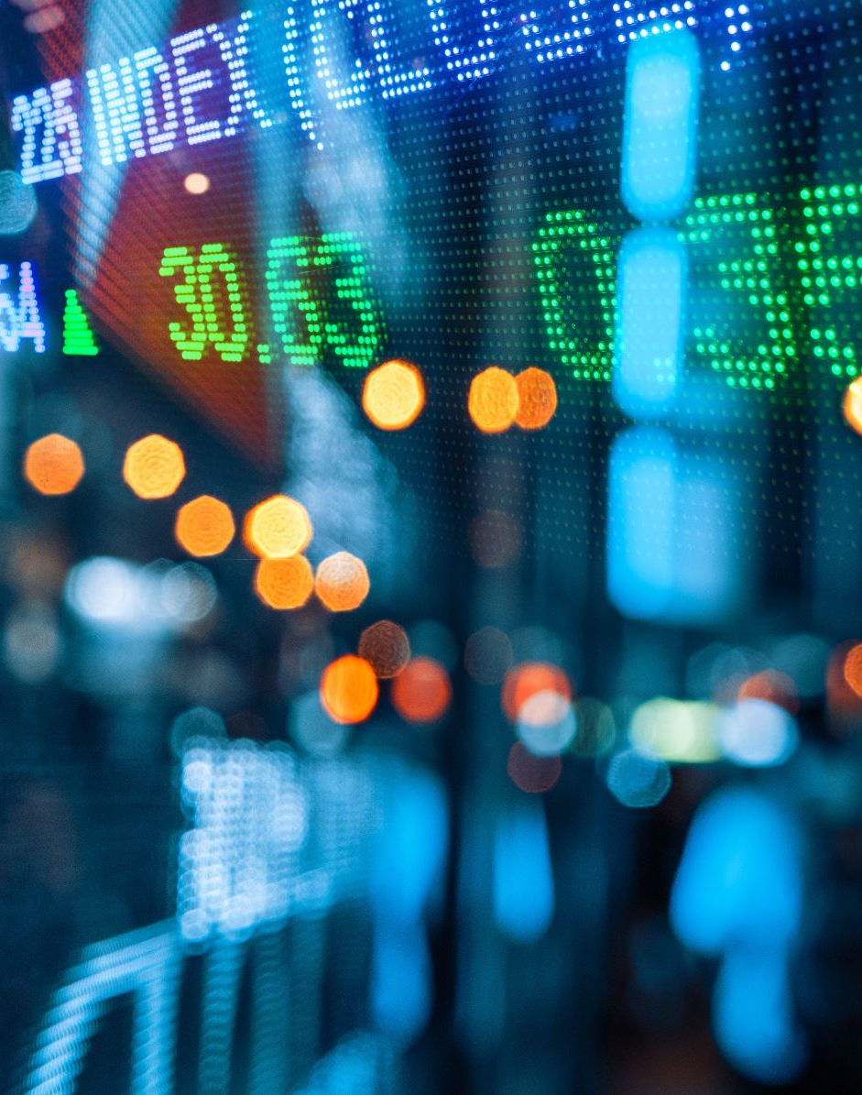
Data Visualizations
1. Aggregate Inflation rate Worldwide 2013-2022 (Altair)
2. 2022 Inflation Rate, Expressed as Percentage of 10-Year Mean (GeoViews)
3. USA Inflation Rate: Consumer Price Index for All Urban Consumers (CPI-U) (hvPlot)
4. I bonds Aggregate Annualized Interest Rate (hvPlot)
5. Cumulative Returns of the Top 5 Stocks & S&P 500 Index (Pandas)
6. Sharpe Ratios of Top 5 Stocks and Index (Pandas)
7. Comparison of Total Returns: Top 5 Stocks, S&P 500 Index, and I bonds (Pandas)
8. Stock Performance Tool

Slide 6

World Inflation Analysis
Datasets (CSVs):
Lat/Lon (Paul Mooney - Kaggle)
World Inflation Data (IMF)
ISO-2 and ISO-3 (Luke Dunalfe – Github)
All creative commons licenses.
Imports: Pathlib, DateTime, hvPlot, pandas, GeoPandas, Matplotlib, NumPy, Vega-Altair, SciPy
Masked and Filtered, based on +/-3 z-score (99.73%)
Data truncated to 10-years.

Slide 7
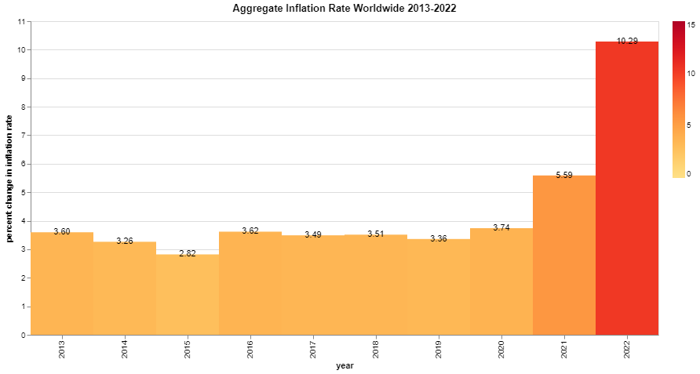
Altair 2D Histogram Heatmap

Slide 8
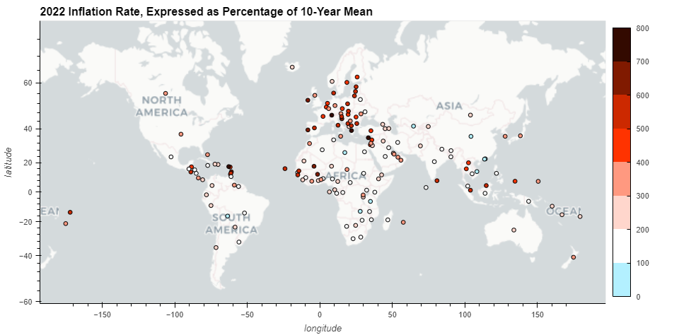
GeoViews Plotted Map

Slide 9
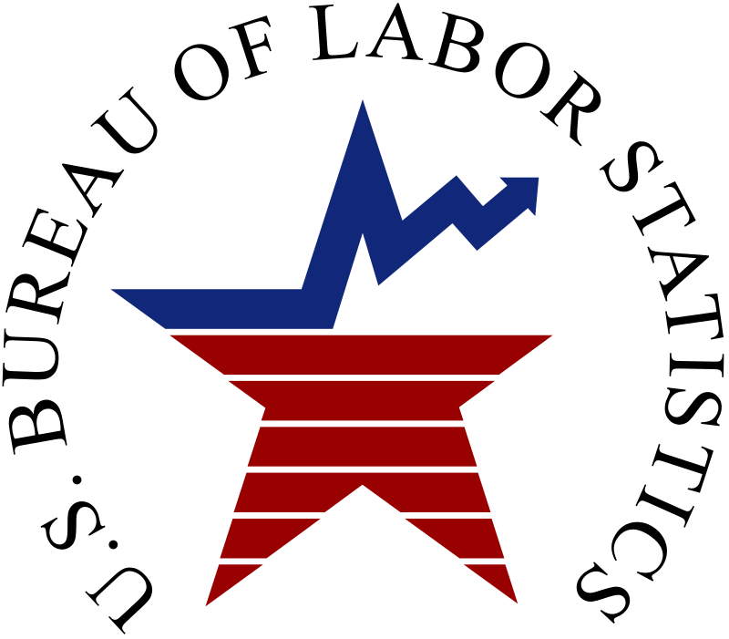
US Inflation Analysis: Consumer Price Index
Dataset (CSV):
Consumer Price Index (CPI-U)
All urban consumers
All available data
Bureau of Labor Statistics
Public domain
Imports: Pathlib, DateTime, Pandas, NumPy, hvPlot

Slide 10
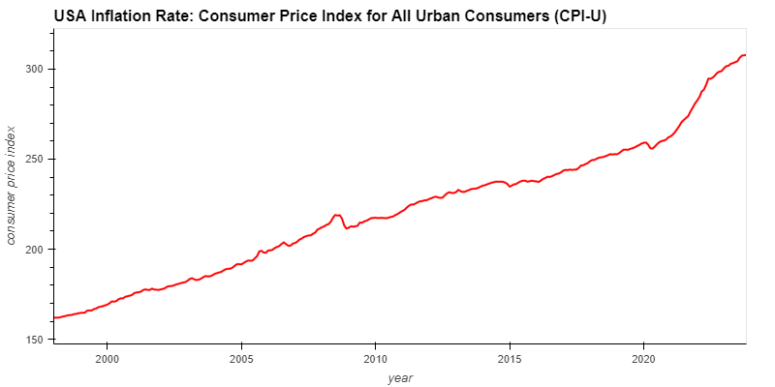
hvPlot Line Graph
Idea for future analysis: Zoom in on adjacent year → slopes

Slide 11
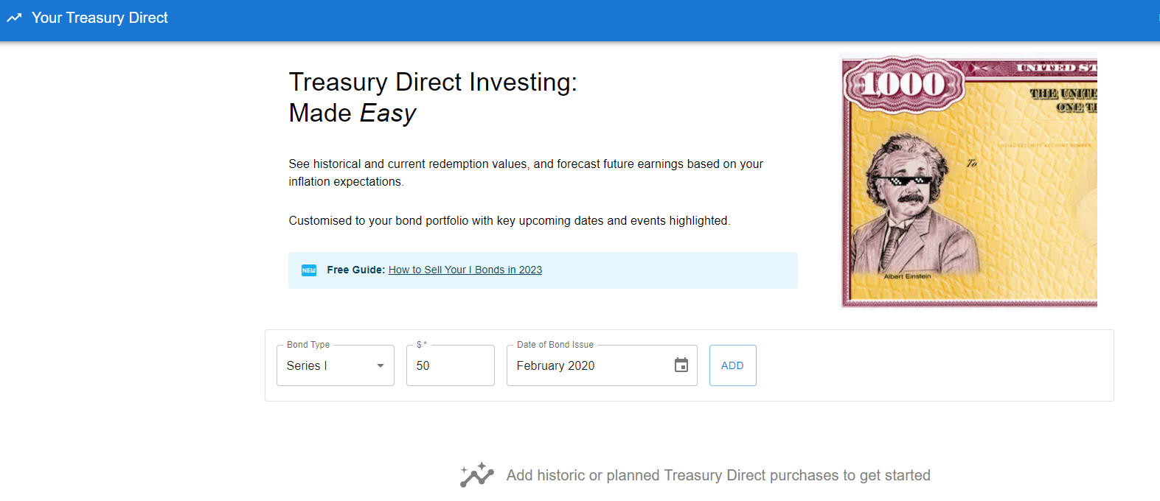

I bonds Analysis
Datasets:
“Your Treasury Direct” (CSV)
www.yourtreasurydirect.com
For-profit company using Treasury Direct data
Asserts some data rights, but does not own the data.
Possibly in violation of public domain license
“Messy” data – strange typos
Treasury Direct (Table in PDF)
Supplementary to patch CSV
Added 2023 values for comparison
Department of the Treasury, Treasury Direct (gov website)
Public domain

Slide 12
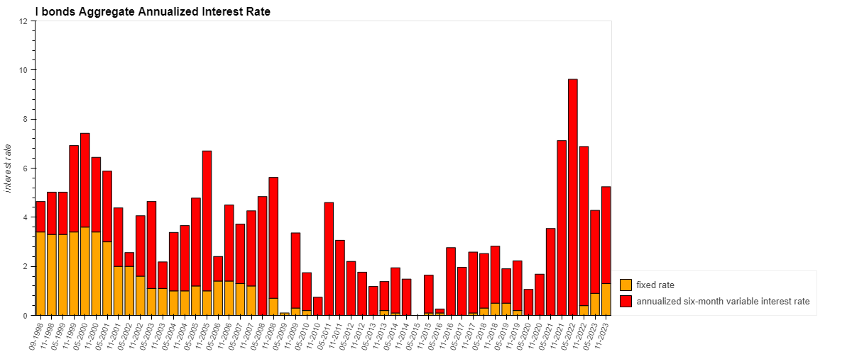
hvPlot Stacked Bar Chart
Note: variable interest rate was annualized from dataset six-month interest rate.
Idea for future analysis: Compare with data about I bond sales during those time-period

Slide 13
Equity Market Analysis: Data and Process
Using yfinance, historical data for S&P 500 were retrieved
A percentage change function was used to find the best 5 performing stocks in 2022 (OXY, CEG, HES, APA, and SLB -all which were from the energy sector)
Further research was conducted to understand the why that was
Upon research, it was concluded that the energy sector in 2022 performed exceptionally with 65.72% gain surpassing the S&P's 11 sectors.
It was reported that OXY brought in about 4.2 billion in second quarter of 2022
This was spurred by a global spike in commodity prices following the Russia's invasion of Ukraine resulting in free cash flow for these companies, high dividends, buybacks and debt reduction

Slide 14
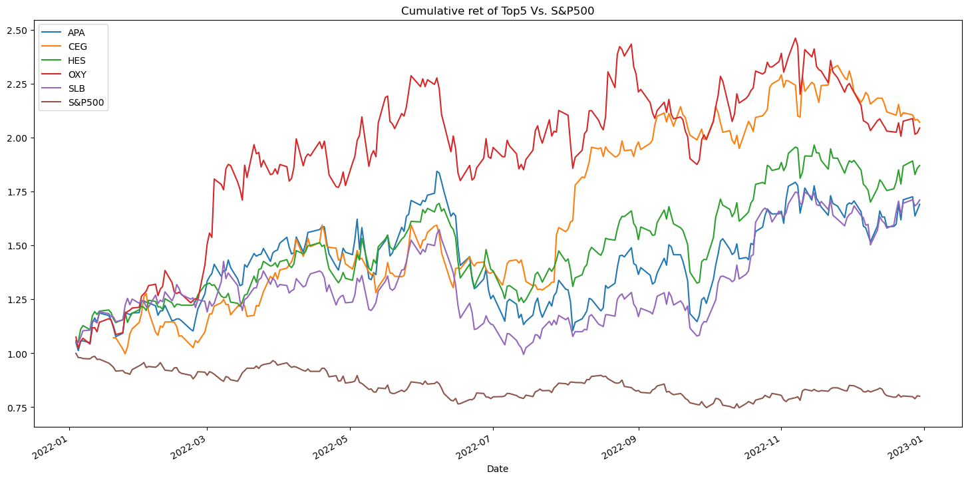
Comparing Cumulative Returns

Slide 15
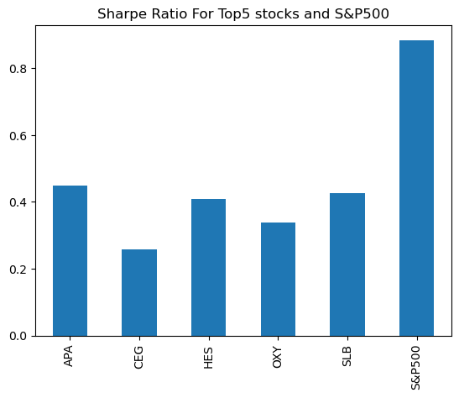
Risk

Slide 16
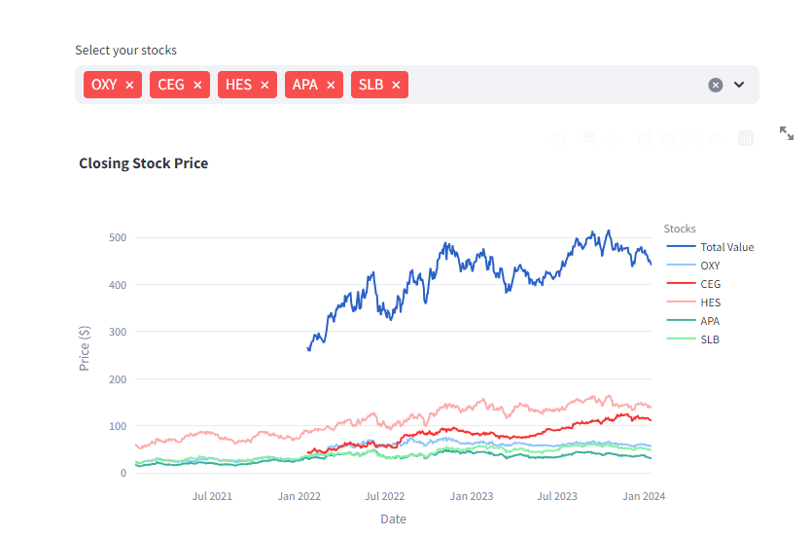
Tool: Individual Stock Performance in 2022

Slide 17

Conclusions
From the analysis, the top5 stocks outperformed the I-bonds rate remaining constant throughout. I'd recommend a risk-tolerant individual who wants to invest a heavily percentage of his or her money in stocks and the remaining in I-bonds for diversification purposes, since the risk to reward ratio is much higher than that of the I-bonds. For a risk averse person, maybe investing heavily in the I-bonds and a portion of the money is the stocks will be appropriate.

